Slide 1
Components Lifecycle Hooks In The React With Crud Operation
ADARSH AJILA

Slide 2

Introduction to React Lifecycle Hooks
Lifecycle hooks are methods that allow you to run code at specific points in a component's life.
Understanding these hooks is crucial for managing side effects in React applications.
This presentation will focus on the mounting phase and its role in CRUD operations.
1
Notes:
Image source: https://www.vrogue.co/post/the-react-lifecycle-methods-and-hooks-explained

Slide 3
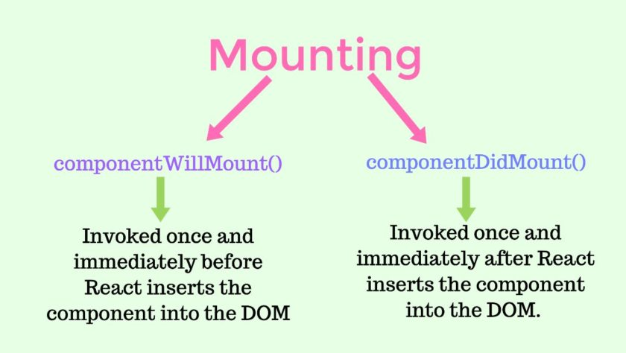
What is the Mounting Phase?
The mounting phase refers to the process of creating a component and inserting it into the DOM.
During this phase, several lifecycle methods are called, allowing for initialization.
Proper handling of this phase is essential for effective component behavior in a CRUD app.
2
Notes:
Image source: https://www.tutorialswebsite.com/lifecycle-methods-in-reactjs/

Slide 4
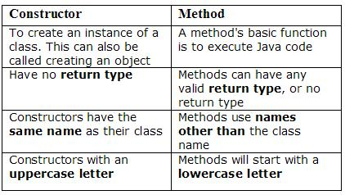
Constructor Method
The constructor is called before the component is mounted and initializes state.
It's the ideal place to bind event handlers and set up initial component data.
Using the constructor effectively can enhance the performance of your application.
3
Notes:
Image source: https://dicksonkho.com/software-road/constructor-vs-method/

Slide 5
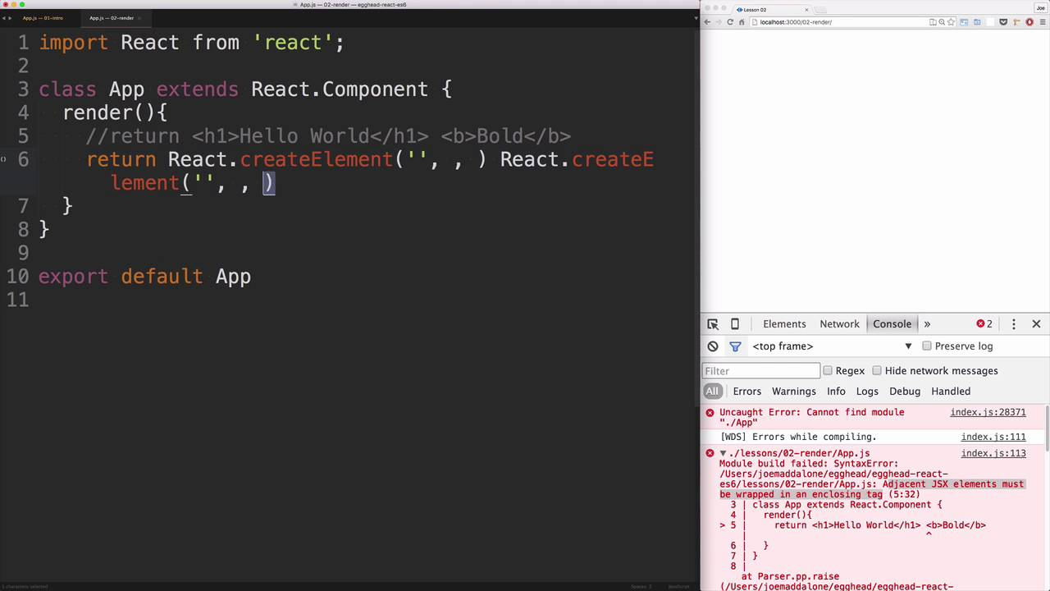
Render Method
The render method is responsible for describing what your UI should look like.
It returns JSX, which React then converts into actual DOM elements.
Proper rendering is crucial for displaying current data in a CRUD application.
4
Notes:
Image source: https://www.youtube.com/watch?v=9JxaffvbRkg

Slide 6
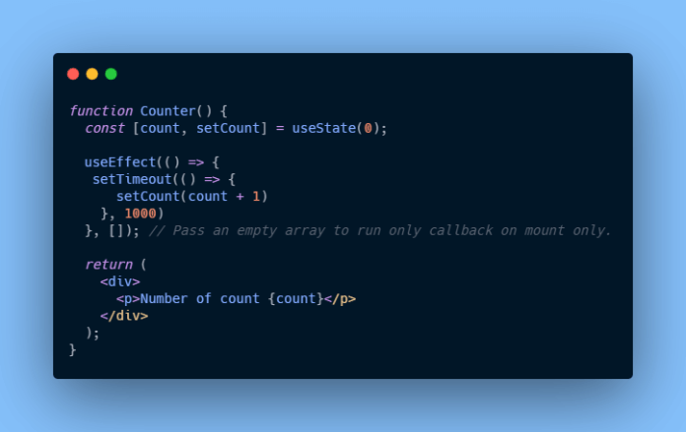
componentDidMount Method
The componentDidMount method is invoked immediately after the component is mounted.
This is where you can perform side effects such as data fetching for CRUD operations.
Using this method allows you to ensure that your component is fully ready to interact with the user.
5
Notes:
Image source: https://www.devcript.com/react-lifecycle-methods/

Slide 7
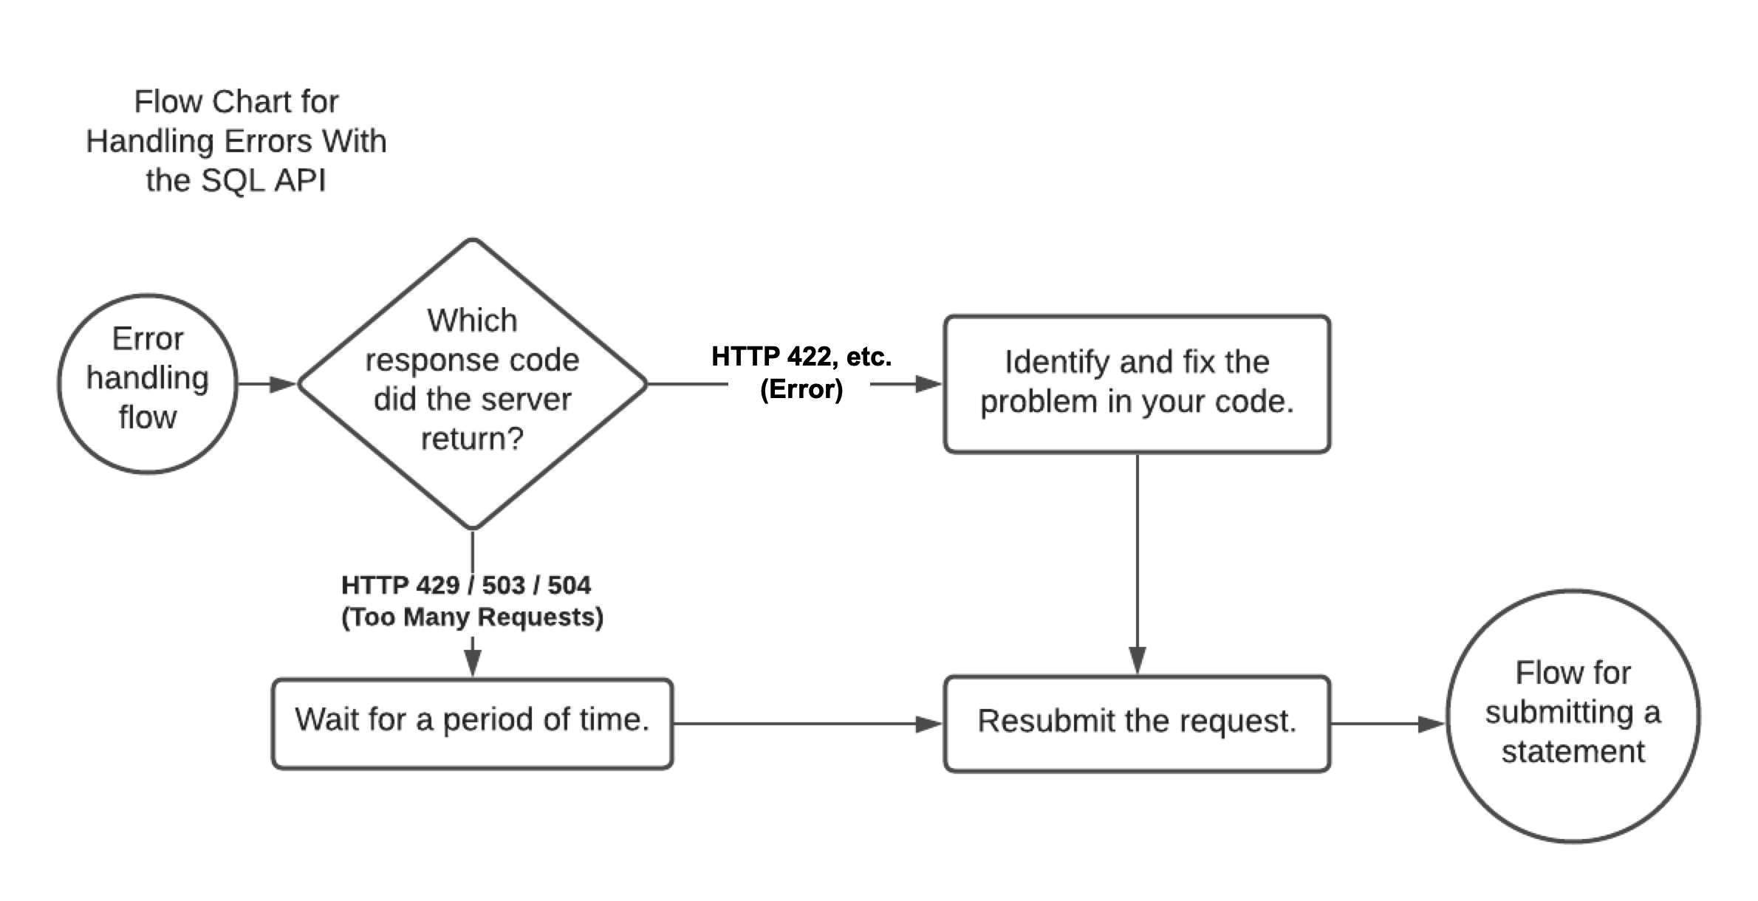
Handling Errors During Data Fetching
Error handling is an important aspect of the mounting phase in CRUD applications.
You should implement try-catch blocks or use `.catch` with promises to handle errors.
Providing feedback to users about errors enhances the overall user experience.
6
Notes:
Image source: https://docs.snowflake.com/en/developer-guide/sql-api/handling-errors

Slide 8
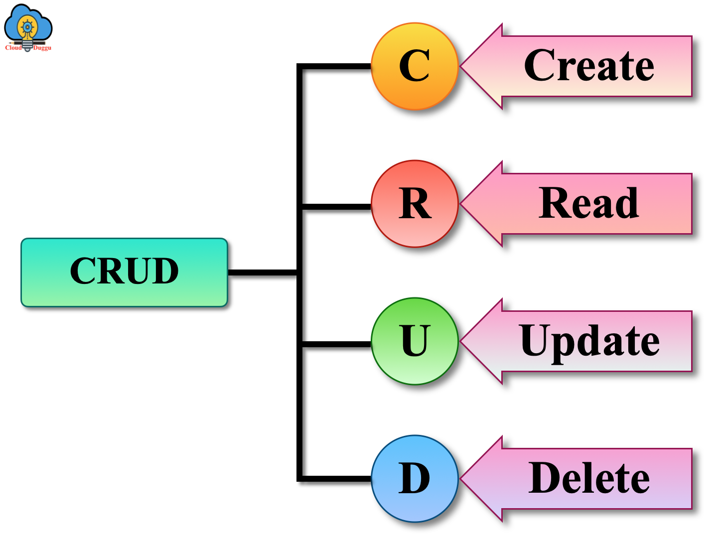
Integrating CRUD Operations
The mounting phase is integral when integrating CRUD operations in a component.
You can fetch initial data and set up the component's state for Create, Read, Update, and Delete operations.
This integration ensures that users interact with up-to-date information.
7
Notes:
Image source: https://www.cloudduggu.com/mongodb/crud-operations/

Slide 9
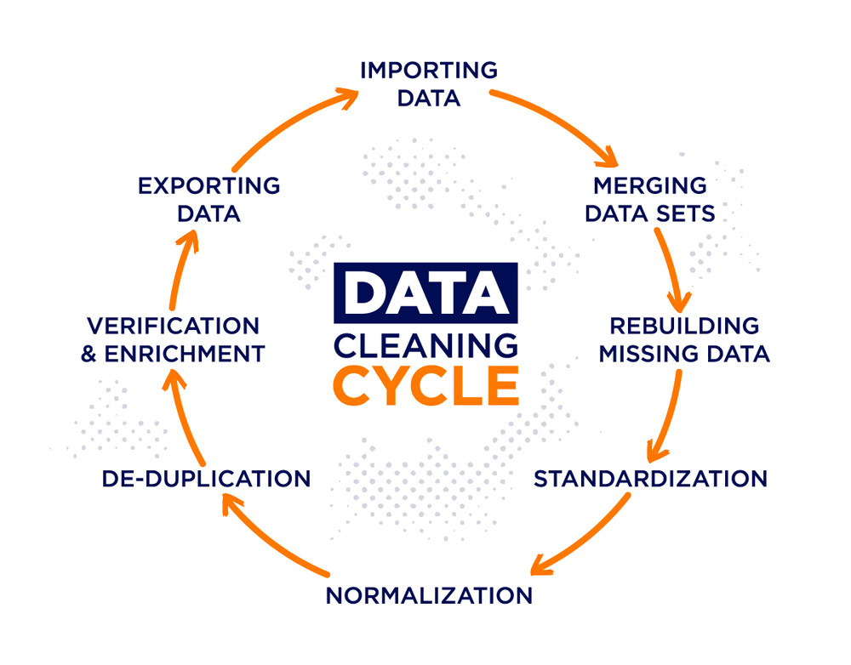
Importance of Clean-up in componentWillUnmount
While not part of the mounting phase, componentWillUnmount is critical for cleanup.
This method is called before a component is removed from the DOM.
Proper cleanup prevents memory leaks, especially when dealing with subscriptions or timers.
8
Notes:
Image source: https://www.crehana.com/blog/transformacion-digital/data-cleansing/

Slide 10
Best Practices for Mounting Phase
Always initialize state in the constructor to avoid errors during rendering.
Use componentDidMount for any data-fetching logic that should occur once.
Ensure error handling is in place to manage potential issues during data retrieval.
9
Notes:
Image source: https://www.tutorialswebsite.com/lifecycle-methods-in-reactjs/

Slide 11
THANK YOU
Notes:
Image source: https://www.tutorialswebsite.com/lifecycle-methods-in-reactjs/

